Slide 1
My T32 Training Grant Experience
Aidan Neher, Biostatistics PhD Student
June 5, 2023
Notes:
Bayesian integrative analysis and prediction with application to atherosclerosis cardiovascular disease (Thierry Chekouo, and Sandra Safo 2023)

Slide 2
What will I share?
Intro: How I came to participate in the program
Research: Longitudinal Bayesian integrative analysis with Mark Fiecas, Thierry Chekouo, and Sandra Safo
Takeaways from first year in T32 training program

Slide 3
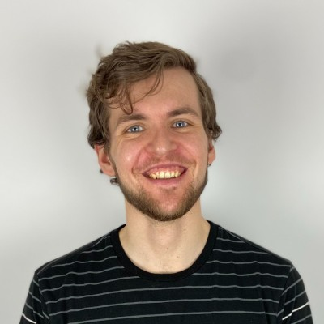
Intro: An overextended year 1
Very much excited, I updated my LinkedIn
Biology major who worked between BA and grad school
Two RAs + Classes = Lots of expectation juggling
Rarely exercised/ took a break/ asked for help …

Slide 4

Intro: T32 offered me time and space
My research consolidated
Technical experimentation e.g. Plink for GWAS
High-Dimensional Work Group: Cooperative learning for Multiview analysis (Ding et al. 2022)
NSF GRFP application: Good learning experience.

Slide 5
Research: Spontaneous connection led to work with Thierry Chekouo and Sandra Safo
The Adolescent Brain and Cognitive Development (ABCD) Study is the largest longitudinal study of brain development and child health in the US
Bayesian integrative analysis and prediction with application to atherosclerosis cardiovascular disease (Chekouo and Safo 2021) foundation for extension
Notes:
In my first year, through an RA, I became familiar with the Adolescent Brain and Cognitive Development (ABCD) Study. The ABCD Study is an ongoing longitudinal research study involving data collection at 21 sites across the United States. It is the largest long-term study of brain development and child health in the US³. The study explores the environmental, social, genetic, and biological factors that affect brain and cognitive development, behavior, and health⁴. There are many data types available, so Mark and I wondered how we might apply Multiview learning in this longitudinal context.
Mark expressed the thought of developing a longitudinal data analysis method to Thierry Chekouo and turned-out Thierry had already been considering such a project. Thierry and Sandra Safo had extended data integration methods for variable selection and prediction to a Bayesian framework in their recently published Bayesian integrative analysis and prediction with application to atherosclerosis cardiovascular disease, which included an R package BIPnet. Thierry, Sandra, Mark, and I first met to discuss extending this method to be capable of longitudinal analysis with application to the ABCD Study early this semester.

Slide 6
Research: About the ABCD Study®
Data available from 21 sites
Neuroimaging data available at 2 time points
Excluded subjects missing neuroimaging data:
N = 7,827 / 11,880 total in the ABCD Study®
Omics data: 34 regions x2 hemispheres x2 structural MRI metrics cortical thickness and surface area = 128 features (for now)
Notes:
Since wanting to extend BIPnet longitudinally, we have started analysis pipeline development, exploratory data analyses, and model formulation. Also, I have spent time getting familiar with C++ and the Rcpp package.
For better or for worse, the COVID-19 disrupted the ABCD Study’s data collection. Neuroimaging data is collected every two years, and the pandemic started between baseline and time point 2 (T2). In our exploratory analyses, we observed substantial neuroimaging missingness at T2. Consequently, we restricted our sample to subjects with neuroimaging data at both time points. Doing so leaves us with 7,827 subjects/ 11,880 subjects invited. There is missingness in the covariates/ response variables we are including but plan to impute this data. Note, when I say neuroimaging data, for now, I mean the two structural MRI metrics Surface Area and Cortical Thickness for 34 regions x2 hemispheres x2 metrics = 128 features.

Slide 7
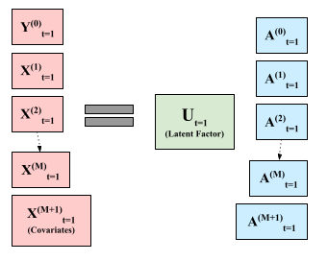

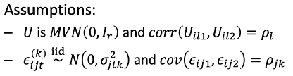
Model: Longitudinal Extension
Indices: i subject, j feature, t time, l component
Notes:
In a Bayesian analysis, we ultimately want the joint posterior distribution, so we can perform variable selection/prediction. While I still need to work through the notation and think through the details, here I am presenting the model at a high level. This represents …

Slide 8
Research: Where I’m at & next steps
Working on cross-sectional implementation in R
A Few Questions:
How might I implement the method so it’s scalable?
Is the combination of imaging data, covariates, and clinical outcomes biologically meaningful? How might we incorporate prior information?
Deadlines are helpful: ENAR paper competition ☺
Notes:
Presently, I have a few questions and next steps I’m pondering.
Firstly, is the combination of imaging data, covariates, and clinical outcomes biologically meaningful? How might we incorporate prior information? At Saonli and Mark’s talk at the Human in the Data Spotlight Series last Thursday, I was reminded of the importance of including a subject matter expert in the conversation, so I’m wondering how, as a student, I might build relationships with non-statistics collaborators.
Secondly, are two time points sufficient for considering the proposed method’s efficacy longitudinally? I’m unsure at present. I have more to read on longitudinal analysis. Perhaps we can include additional data as it’s released or might consider adding/ switching to other data.
Thirdly, how might I implement the method so it’s scalable? Sandra mentioned her general preference for frequentist methods thanks to their relative computational efficiency, but Bayesian methods offer the chance to incorporate prior information. I’m wondering how to architect the software so adding additional omics data doesn’t increase the runtime beyond practicality.
Regardless, I’m planning to submit this work to this fall’s ENAR student paper competition.

Slide 9
T32 Takeaways
Benefits:
Time and space to explore my interests, learn new technologies, and do methods work
NIH covers most of Graduate Assistant Health Plan
Challenge: Methods work in and of itself exposes me to less variety/ collaborations with subject-matter experts
Notes:
On the first con,

Slide 10
Thanks!
Mark Fiecas, Thierry Chekouo, and Sandra Safo for their mentorship
NIH for funding
T32 training program and its organizers Saonli Basu, Tianzhong Yang, and Wei Pan
Biostats faculty generally, fellow students, family, and friends for their support
Notes:
Finally, I’d like to acknowledge Mark, Sandra, and Thierry for their mentorship, and the NIH for making this work possible. Also, thanks to this Stat Gen training program, its organizers Saonli, Tianzhong, and Wei Pan, the biostats faculty generally, fellow students, family, and friends for their support.

Slide 11


Slide 12
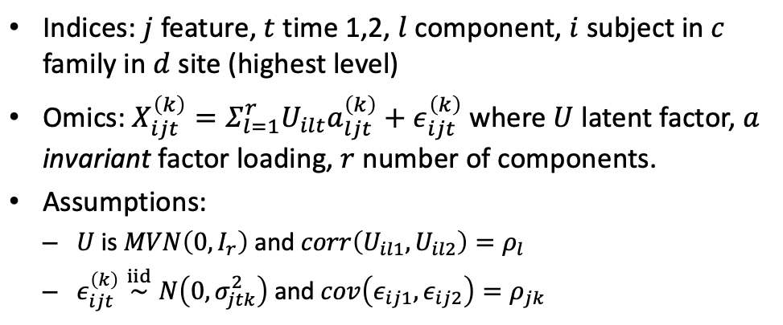
Model: Longitudinal Extension
Notes:
In a Bayesian analysis, we ultimately want the joint posterior distribution, so we can perform variable selection/prediction. While I still need to work through the notation and think through the details, here I am presenting the model at a high level. This represents …

Slide 13
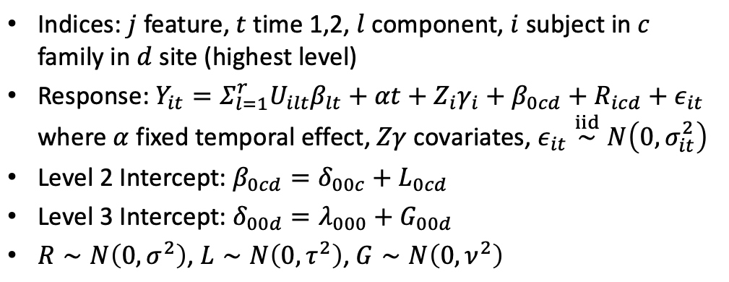
Model: Nested Random Effects
Notes:
One complication of the ABCD Study is that data is collected across 21 sites and subjects might share the same family. The variables … represent random intercepts to account for nested effects, but we need to interpret/resolve error terms in relation to these random effects in the outcome equation.

